Slide 1
Autonomic Orchestration in Norwegian use-case
Hoa Thi Nguyen

Slide 2
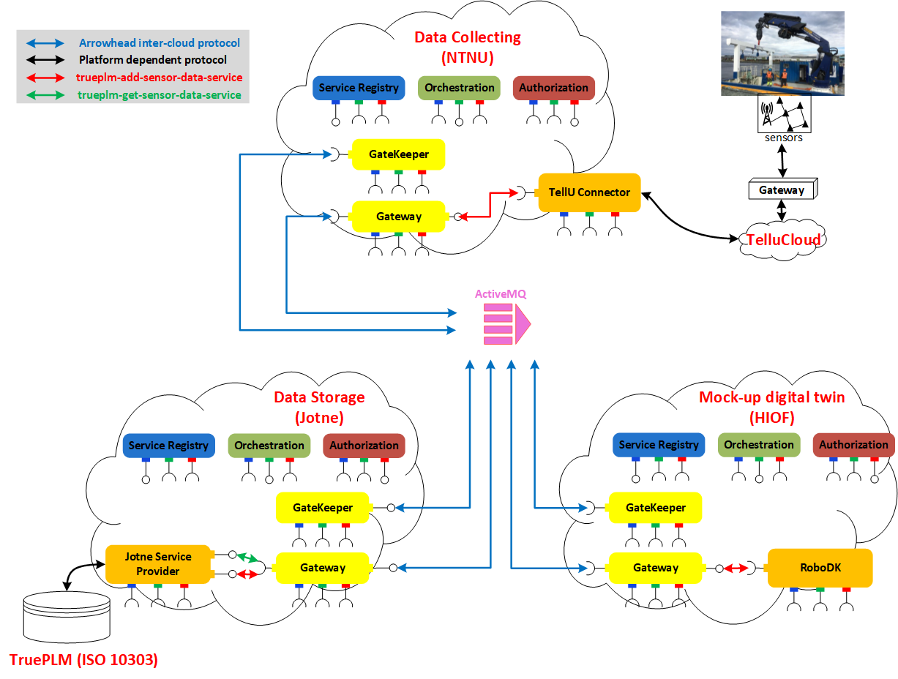
The Norwegian use case

Slide 3
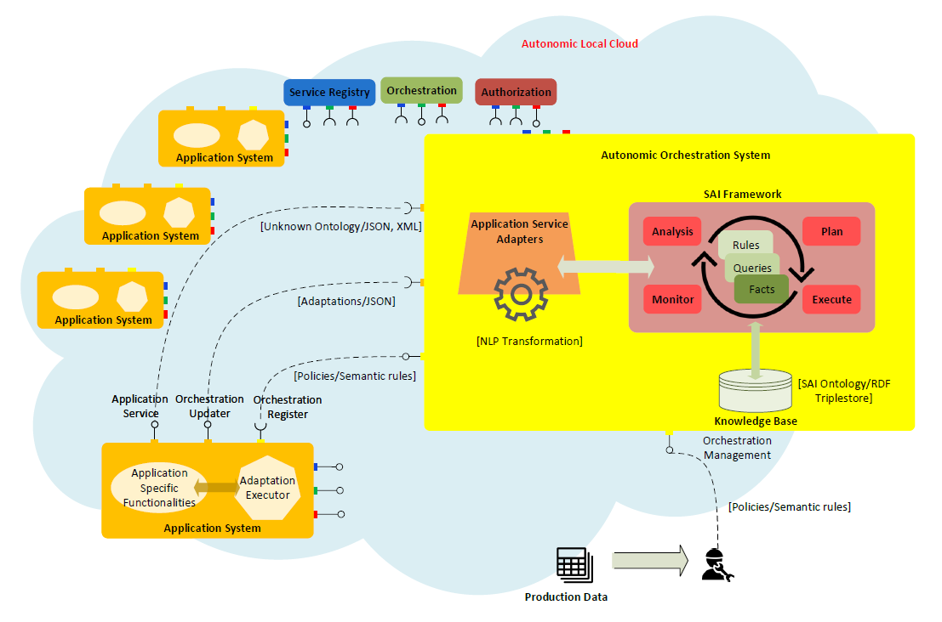
Autonomic Computing
Autonomic computing is a concept that “brings together many fields of computing with the purpose of creating systems that self-manage
Autonomic Orchestration System:
Service-oriented Autonomic IoT (SAI) platform
Guide the Application Systems to replace/substitute their being used services by other equivalent services for the purpose of self-healing or self-optimization.

Slide 4
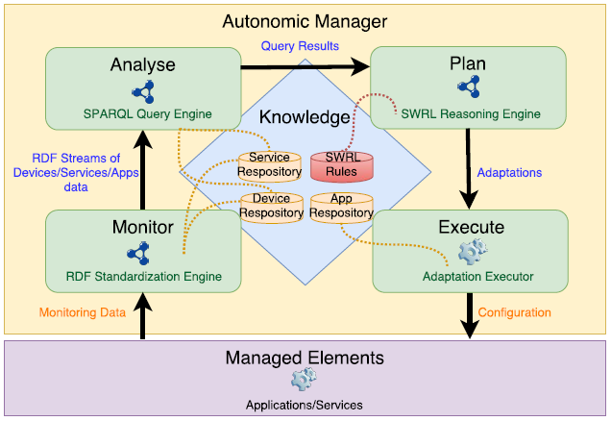
Autonomic Manager
Adaptive loop: executing adaptation rules
Knowledge is predefined

Slide 5
Autonomic Manager
Adaptive loop: executing adaptation rules
Learning loop: acquiring new adaptation rules from experiences

Slide 6
Autonomic Manager
Adaptive loop: executing adaptation rules
Learning loop: acquiring new adaptation rules from experiences
Expensive
Risky

Slide 7
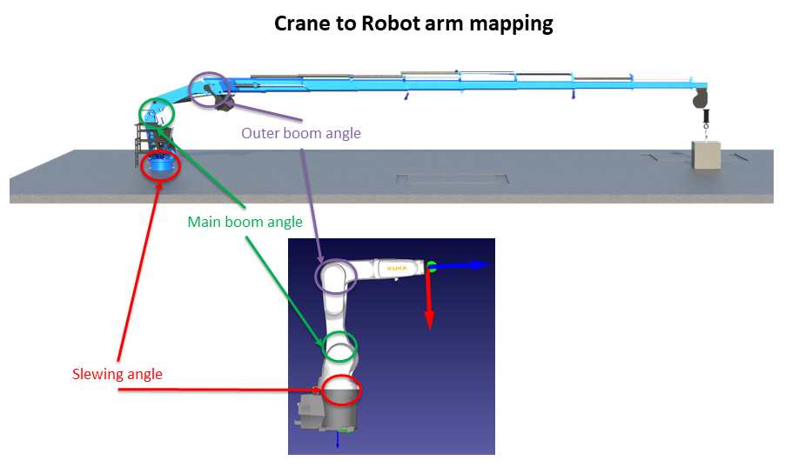
In-house laboratory
Replica of the digital crane with robot arm to demonstrate autonomic adapting

Slide 8
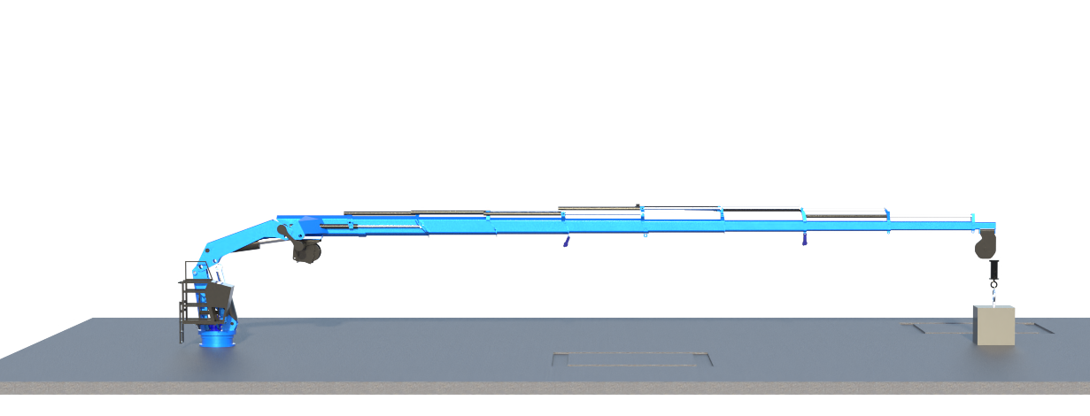
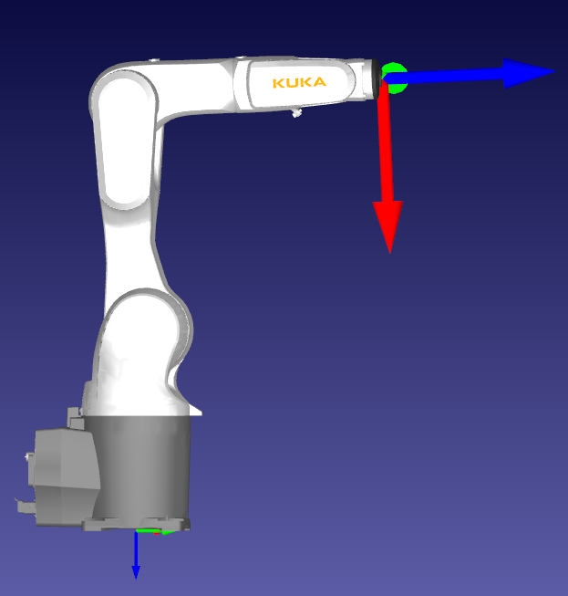
Crane to Robot arm mapping
Outer boom angle
Main boom angle
Slewing angle

Slide 9
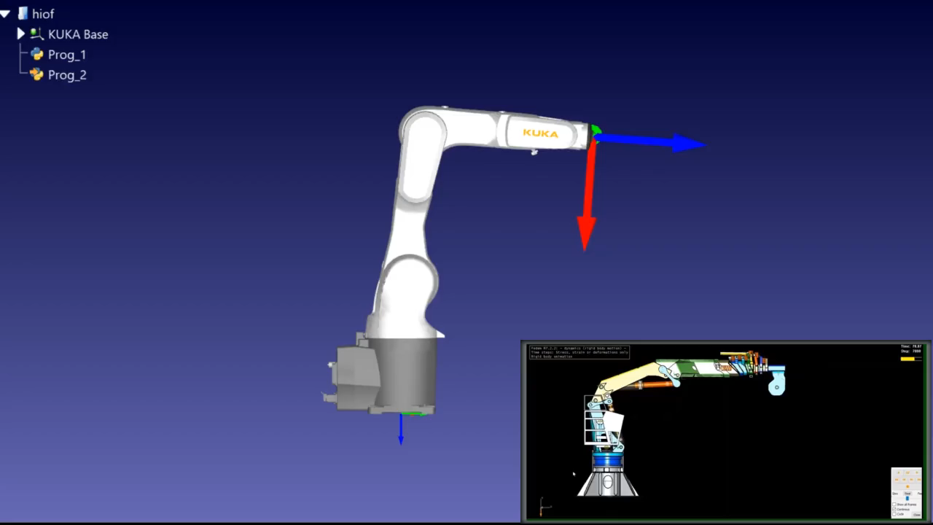
Demo

Slide 10
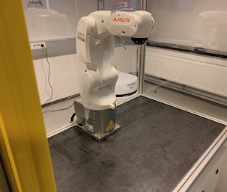
Knowledge transferring
Learning is expensive, can we reuse what we have learnt?
Knowledge

Slide 11
Q & A

